Slide 1

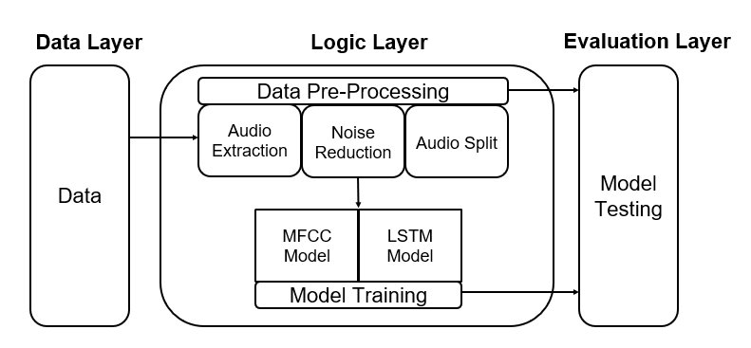
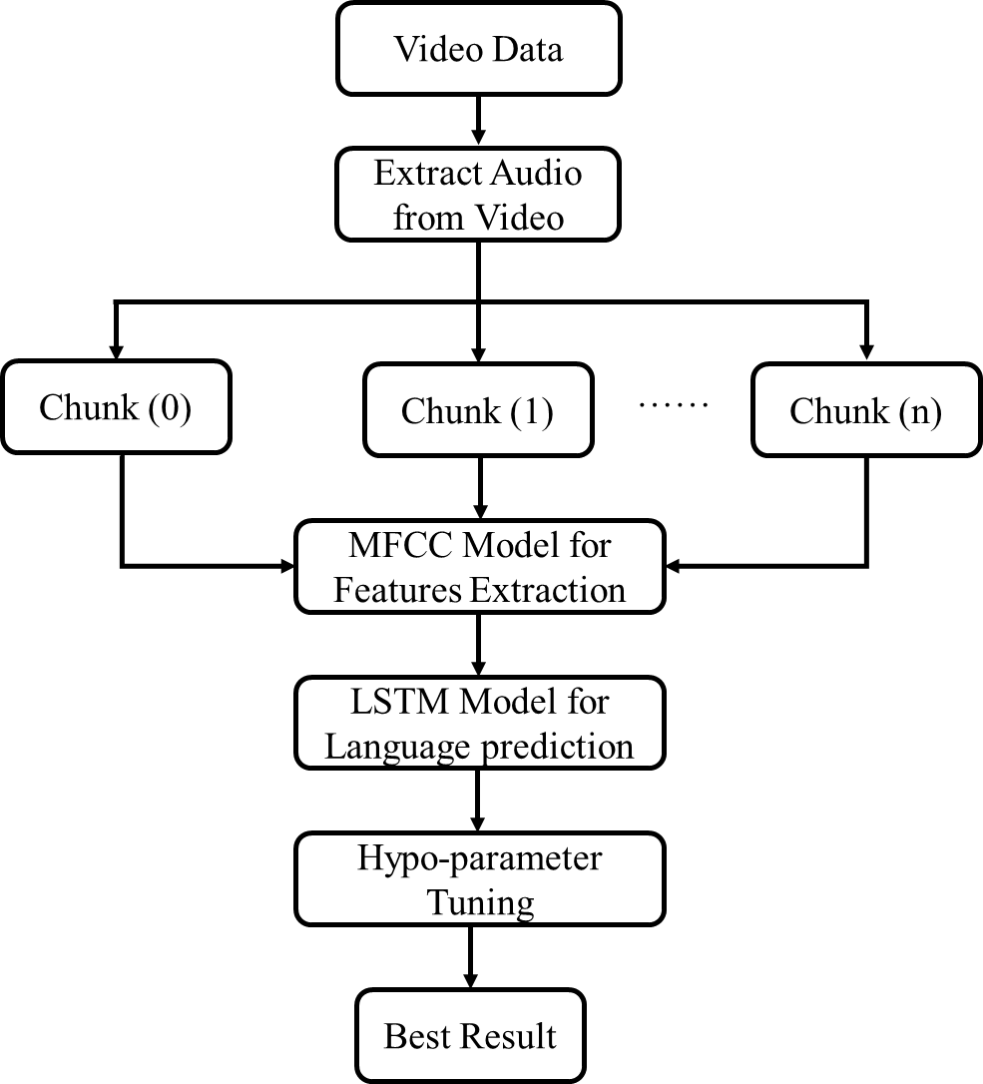
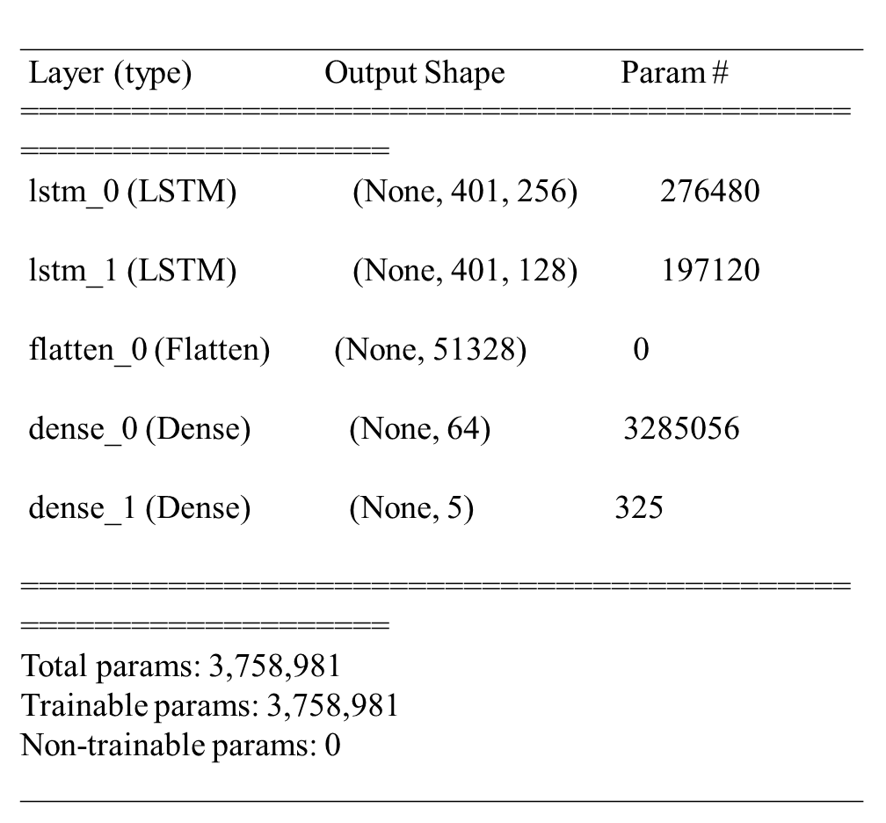
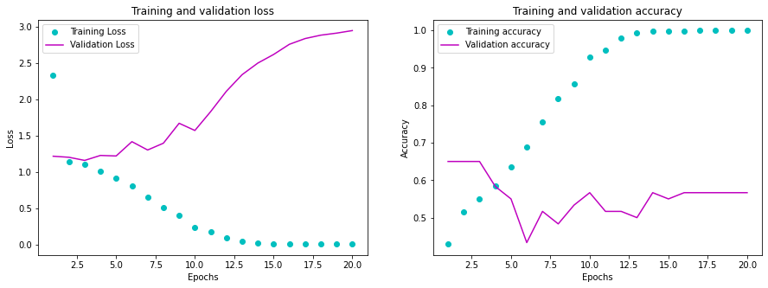
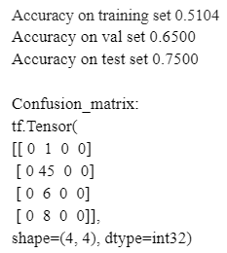
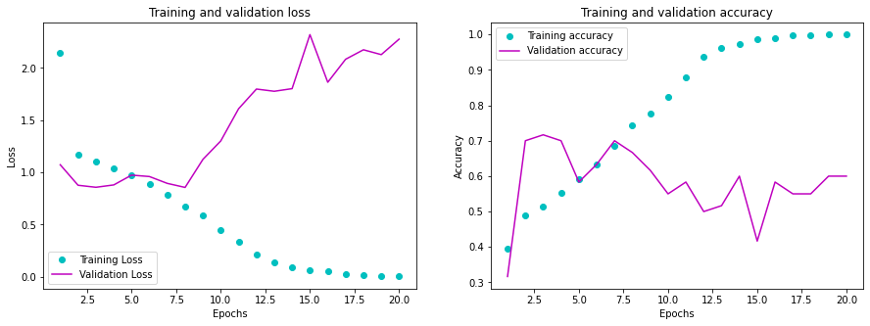
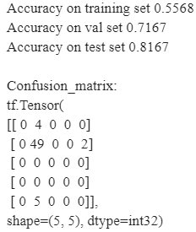
Team Agile - Identify Language of Instruction
Han Zhang, Rongruo Zhou, YuanYuan Lei, Dongqing Yang, Jin Huang, Pei Chen
Dept. of Computer Science & Engineering
Introduction
System Design
The education department at TAMU has been assigned the task of improving the schools around the state of Texas. In order to understand the quality of lectures which have been recorded by various schools, they survey the video for certain cues and classify the video into different categories. For a language lecture where English is being taught to students, they classify the video based on how much English / Chinese is being spoken and being used in conversation. This helps them identify the mistakes in the lecture and accordingly guide the professor in order to improve it. This specific task, of identifying language, we try to emulate using software. We create a system which extracts audio from these videos, processes it and identifies the language spoken.
Overall Flow of Code
Model Structure
Table 1 LSTM Model Structure
Structure introduce
MFCC feature:
nfft = 1103, winstep = 0.1
return (401, 13)
Figure 1. Overall Flow Diagram
Experimentation Results
Challenges / Future Works
The biggest challenge faced while the execution of the project was to remove the noise and improve the quality of the video. For further research, special audio boosting and noise removal mechanisms can be used which are generally used in signal analysis. In order to improve the model, a model designed with a smaller subset of languages can be chosen so as to better identify the audio.
We can take a step ahead and also explore tensorflow/scikit learn to understand and develop the deep learning approaches to analyse audio data and language recognition. Specific Natural Language Processing models can be used extensively and hyper-parameters tuning can be explored further.
Figure 2. Prediction For Language of Teacher
Conclusion / Feedback
The client expected a proof of concept application to evaluate languages in lecture videos and the same has been successfully implemented. We learnt that the prediction for language of teacher and prediction for language of students work well with the existing model. We learnt about the various libraries and frameworks used to process videos and audios. We also learnt about the various phases in Software Engineering and the importance of them in order to create a successful project. This project can be a good starting point for the eventual aim of education department to automate evaluation of recorded lectures. We have an agreement with our customer team to write a paper together to publish our result in the educational filed.
Figure 3. Prediction For Language of Student
Lessons Learnt
We would like to thank Dr Walker and Dr Beverly to give an opportunity to work on such an exciting project. The vision of the education department is to give real-time feedback to the professor teaching in the class, which would greatly improve the quality of students. This also gave us an insight about how the education team is striving to benefit and improve the life of students and teachers. This is a small contribution in the journey towards achieving it. We also learnt a lot from this project. We now have a more in-depth and comprehensive understanding of how to build a machine learning model. We learned to how to process the data, extract the data features, build and train the data model and finally analysis the outcome. It is a valuable experience to work as a team and weekly communicating with customers.

